Slide 1
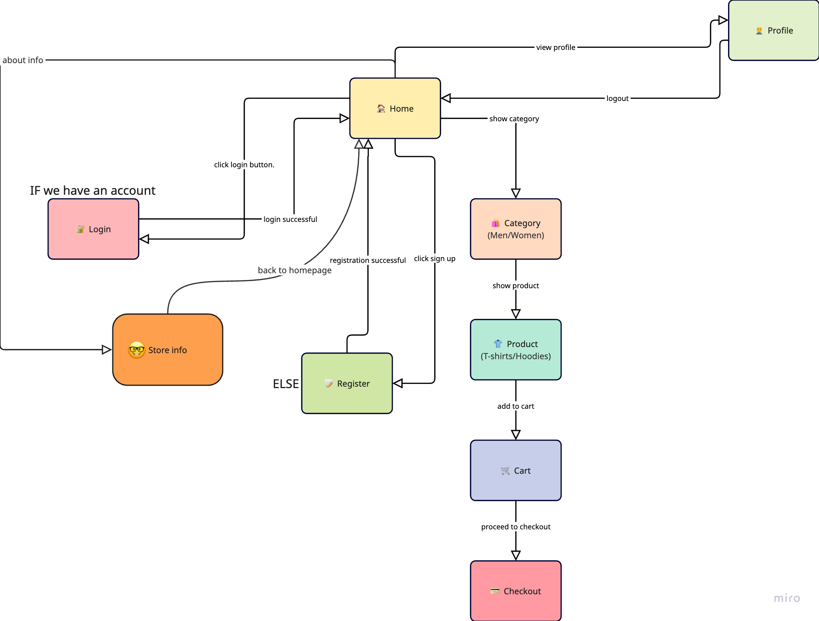
Conceptual Model

Slide 2
Task was done by:
Alnur Nurumov, Saad Makhdoom, Ali Akbar

